Slide 1
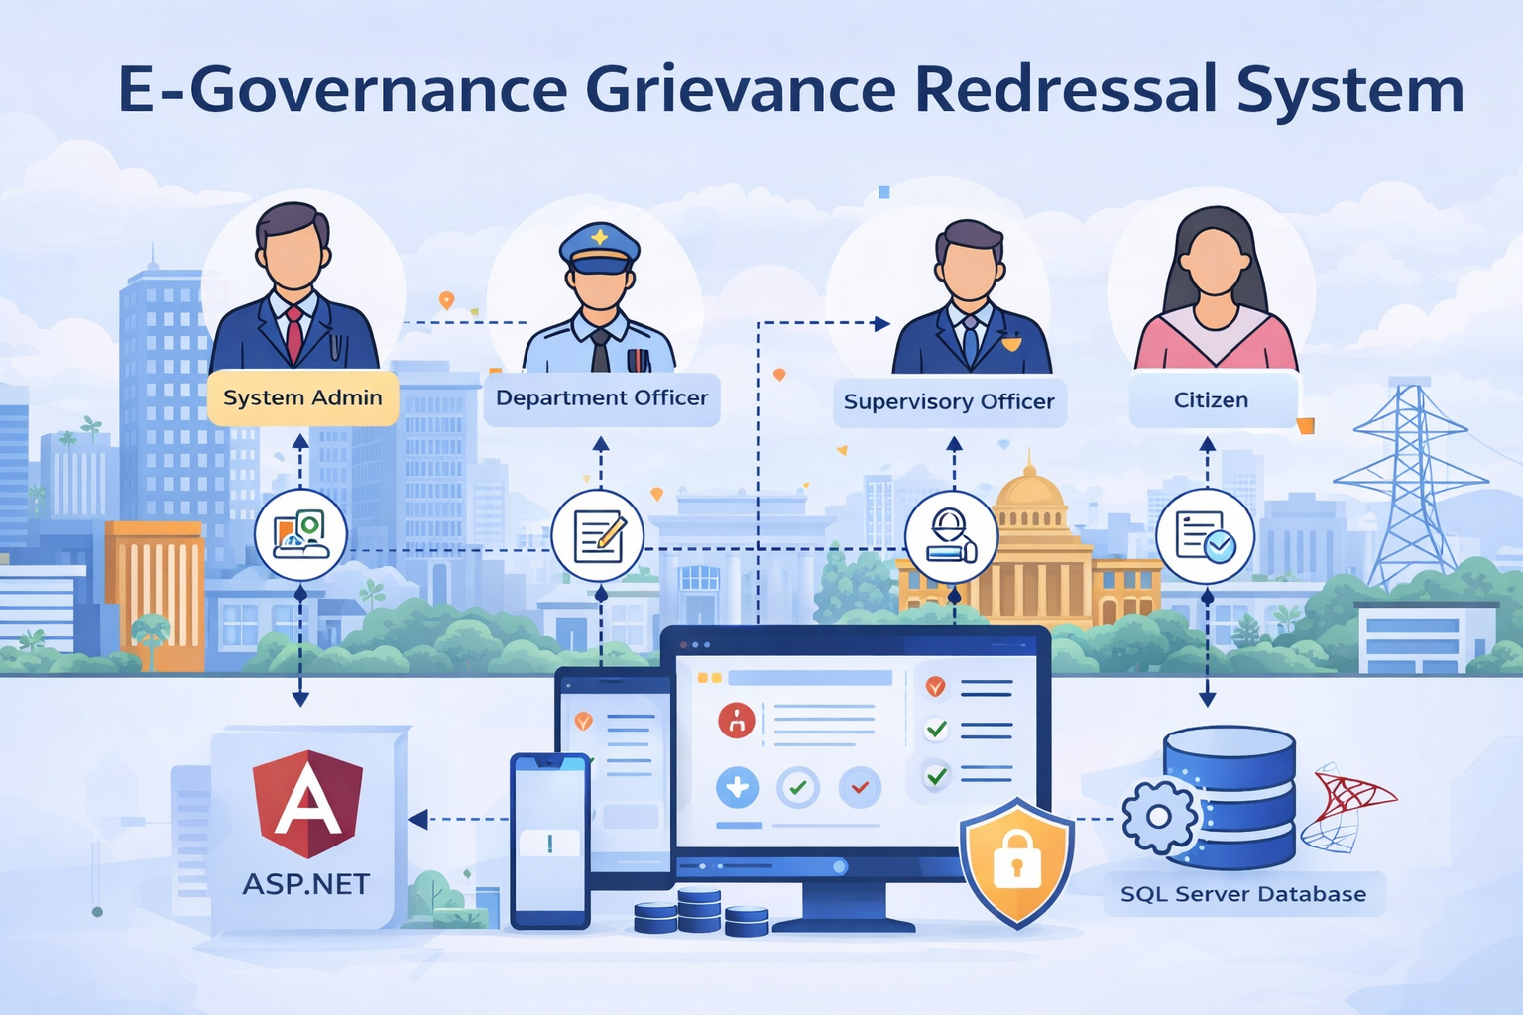
E-Governance Grievance Redressal System
A secure, scalable e-governance platform designed to streamline citizen grievance filing and automate departmental resolution workflows using ASP.NET Core and Angular.
Author: D Pruthvi Reddy
Date: 07-01-2026

Slide 2
Project Overview
Objective: To design and develop a secure, centralized E-Governance platform that enables citizens to submit, track, and resolve grievances across various government departments efficiently.
Technology Stack: ASP.NET Core (Backend), Angular (Frontend), and SQL Server (Database).
Duration: Ten Days.
Problem Statement: Manual grievance handling leads to a lack of transparency, delayed response times, poor accountability, and no centralized tracking system for public service complaints.

Slide 3
Problem Statement
The government currently lacks a centralized, transparent system for managing public service complaints, leading to inefficiencies and a lack of accountability in grievance handling
Manual Handling Inefficiency: Many grievances are currently processed manually or via email, resulting in delayed responses and unresolved complaints.
Lack of Transparency: There is no centralized system for citizens to track their grievance status in real-time.
Accountability Gaps: Poor accountability across departments makes it difficult to monitor service quality and resolution timelines.
Data Silos: A lack of centralized reporting prevents authorities from accessing analytics on department performance and resolution efficiency.

Slide 4
Solution & Key Features
Grievance Lifecycle Management
End-to-end tracking of complaints through stages: Submitted, Assigned, In Review, Resolved, and Closed.
Smart Dashboards
Role-specific views for Citizens to lodge complaints and Officers to manage their workload effectively.
Secure Access
Multi-layered security using JWT and Role-Based Access Control (RBAC) to protect sensitive citizen data.
Data-Driven Insights
Comprehensive reporting on resolution times and department performance using LINQ-based analytics.

Slide 5
Technology Stack
🎯 Backend
Developed using ASP.NET Core Web API (v8/9) utilizing a Layered Architecture (Controller, Service, Repository) for maintainability.
⚡ Frontend
Built with Angular, featuring a modular architecture with Auth Guards, Interceptors, and Reactive Forms for a responsive UI.
🔒 Roles
System Admin: Manages users and departments.
Department Officer: Resolves grievances
Supervisor Officer: Assigns and close the grievances ,monitoring is also done.
Citizen: Registers and tracks complaints.
📊 Database
SQL Server managed via Entity Framework Core, storing relational data for Users, Grievances, and Departments.

Slide 6
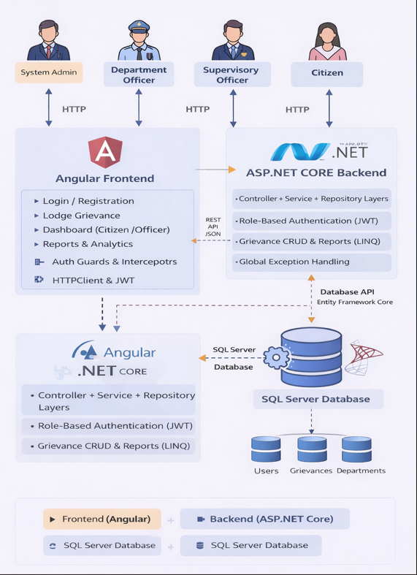
System Architecture
System Architecture Diagram

Slide 7
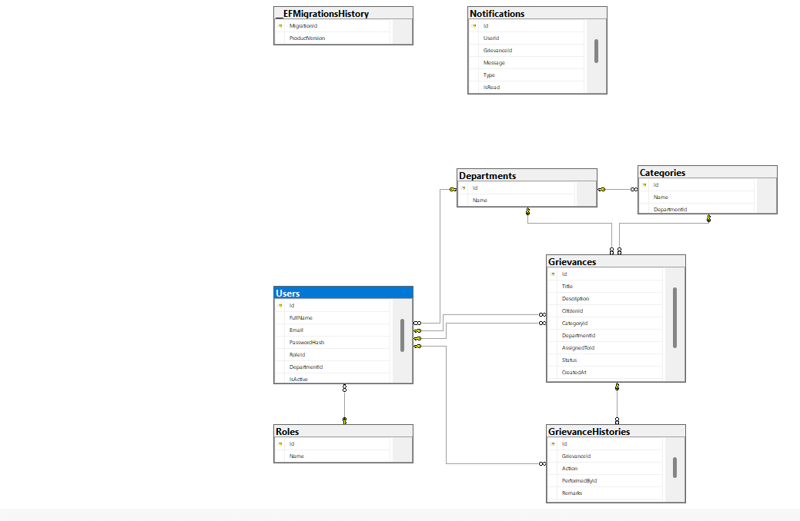
Database Schema Diagram

Slide 8
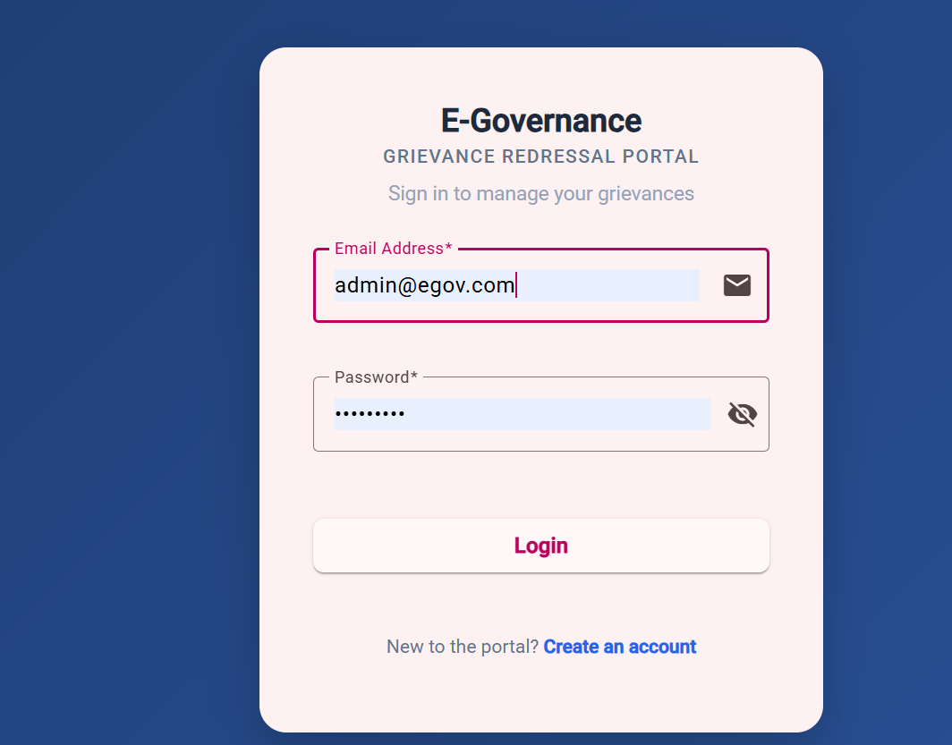
Login Page(UI)

Slide 9
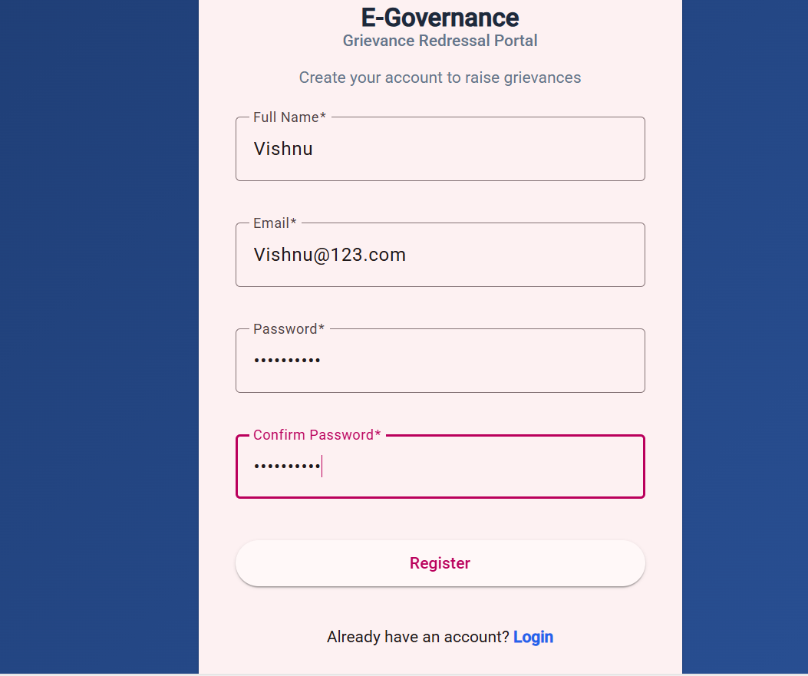
Registration Page

Slide 10
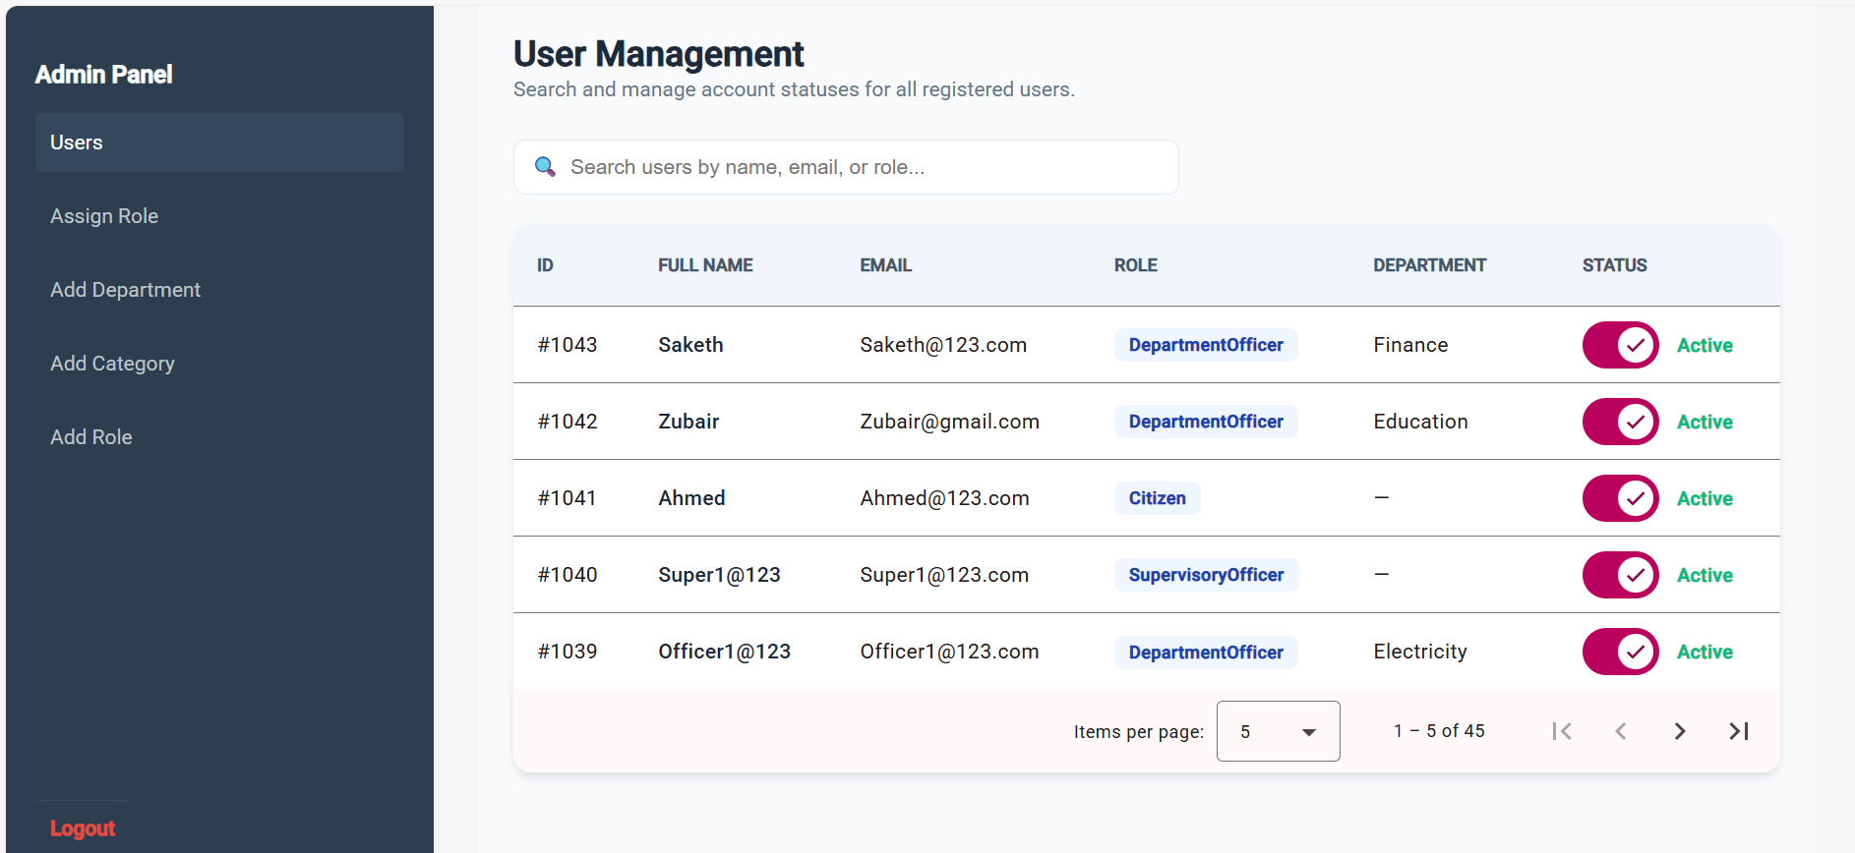
Admin Dashoboard

Slide 11
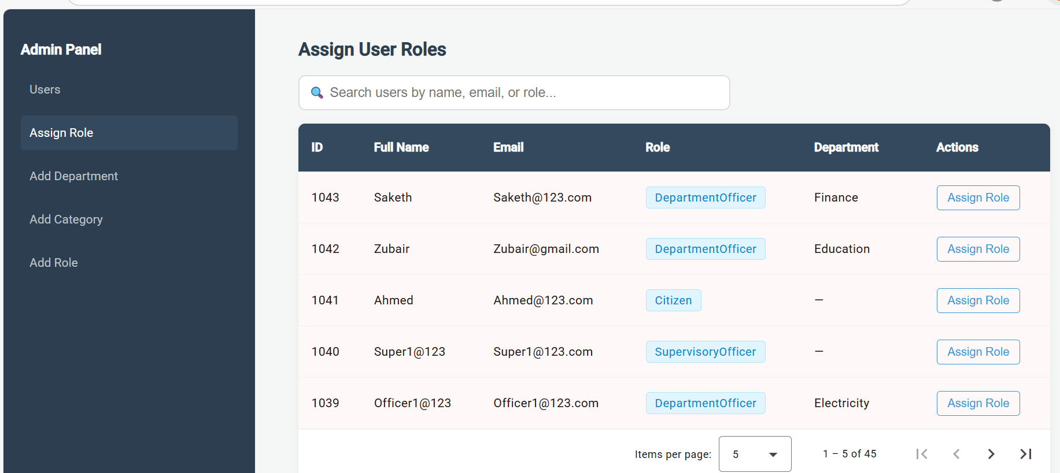
Admin Dashboard/Assign Role Page

Slide 12
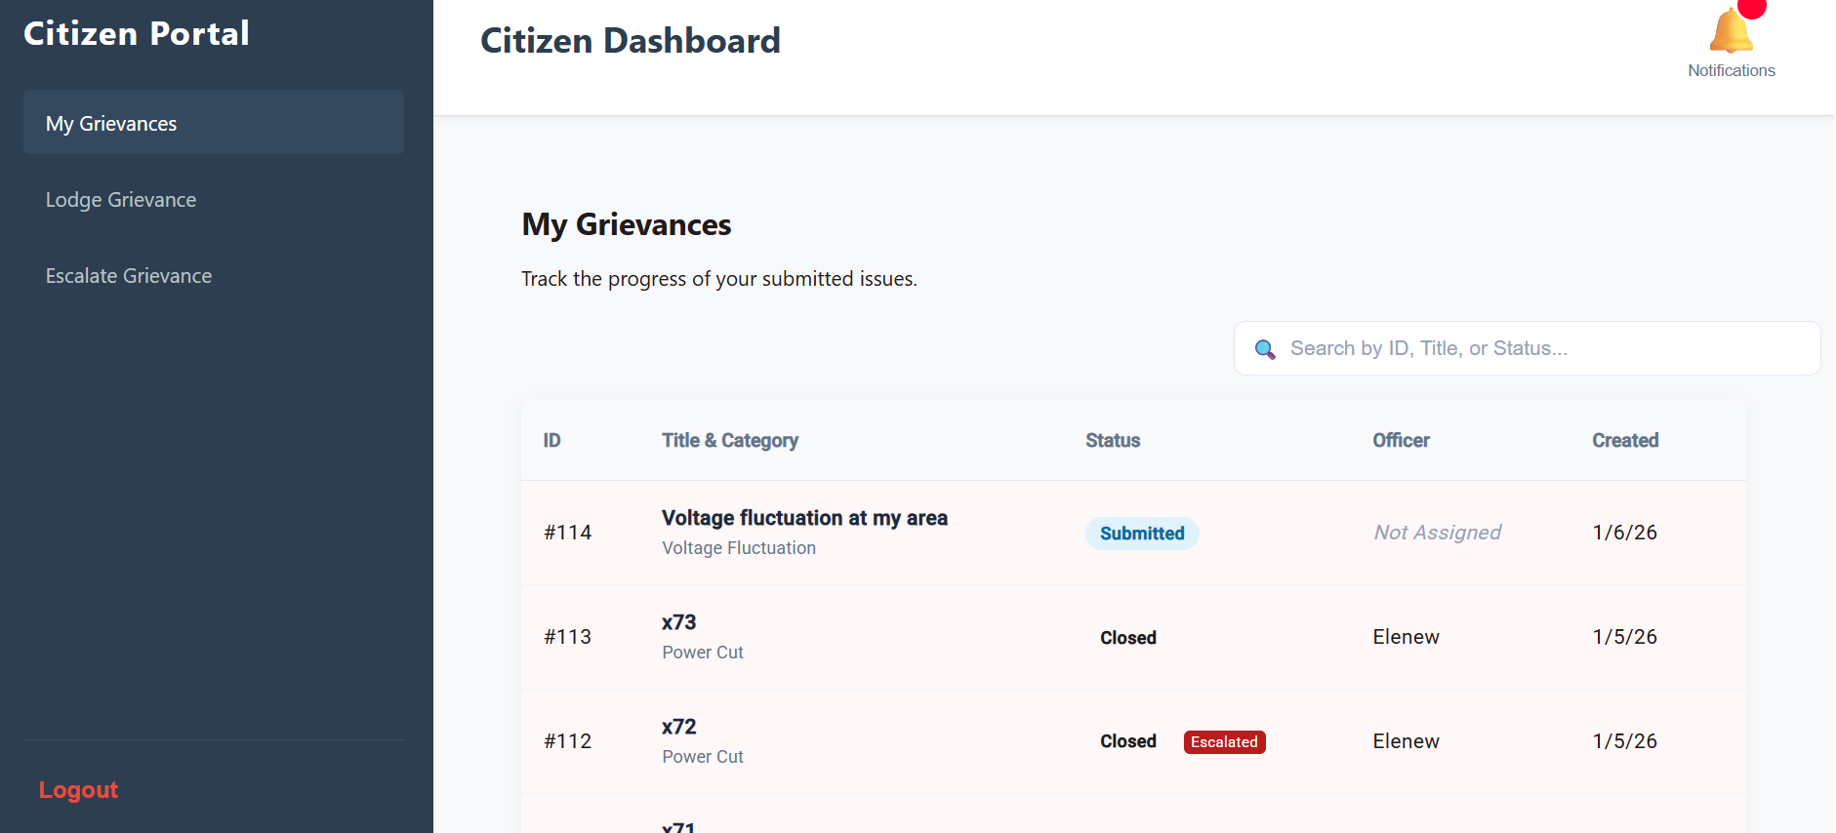
Citizen Dashboard/My Grievances Page

Slide 13
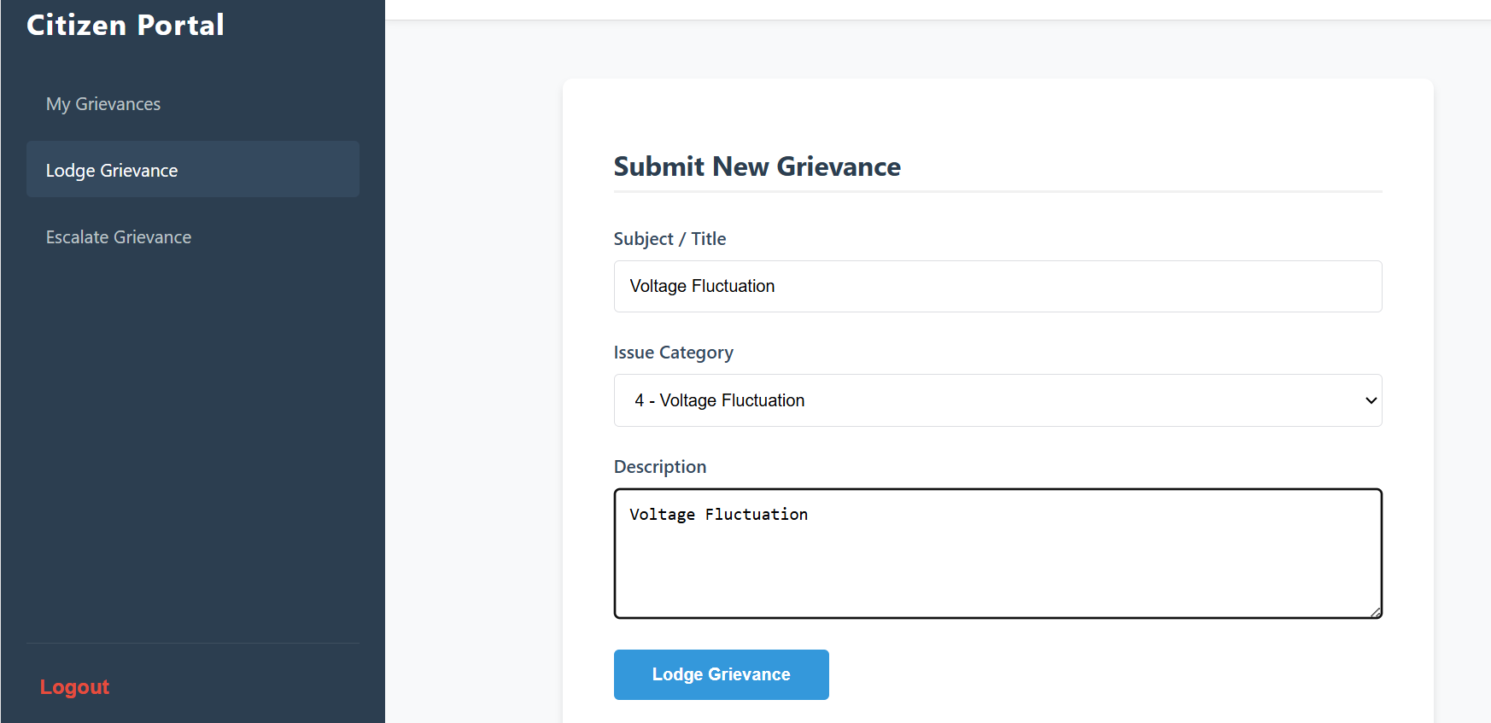
Citizen Dashboard/Lodge Grievance Page

Slide 14
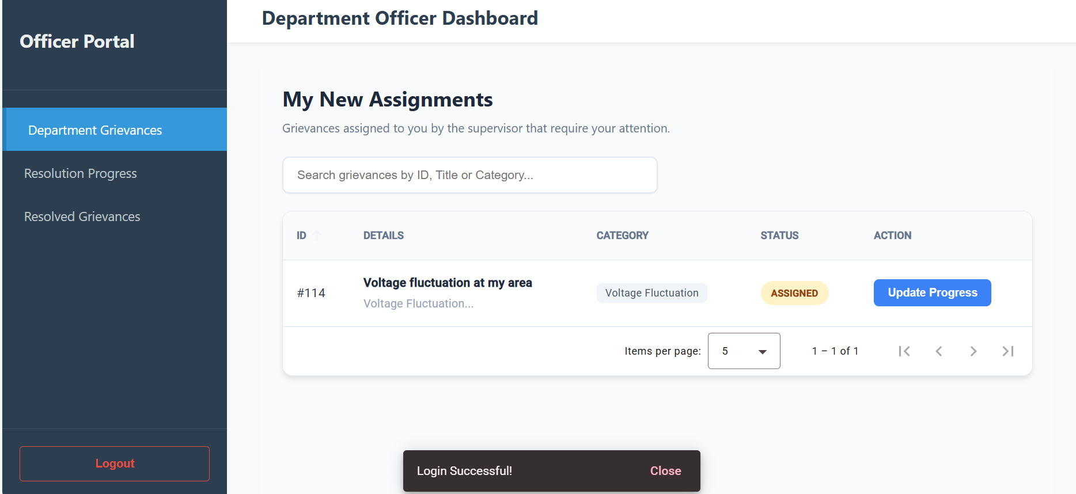
Department-Officer Dashboard/Department Grievances Page

Slide 15
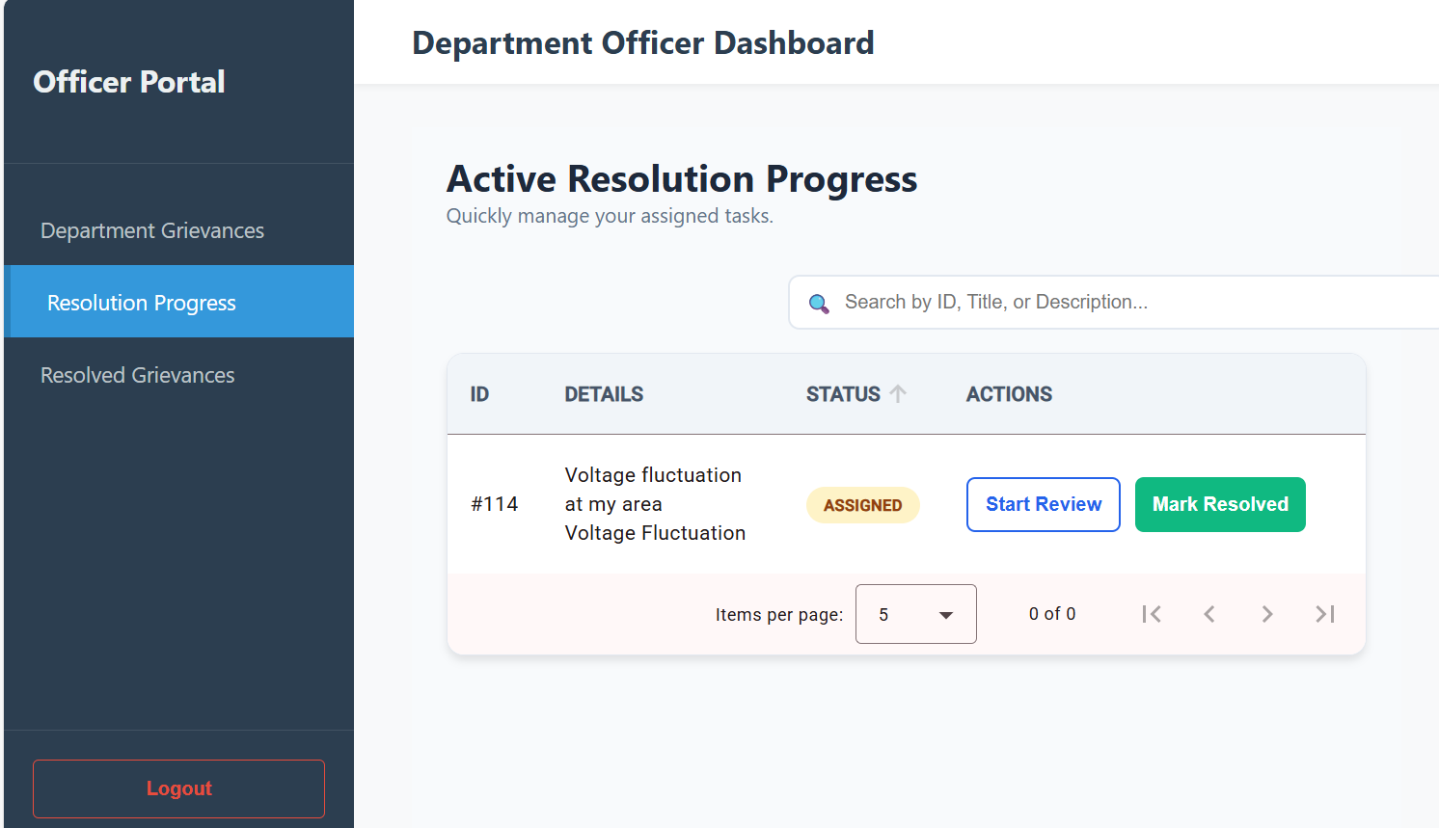
Department-Officer Dashboard/Resolution Progress Page

Slide 16
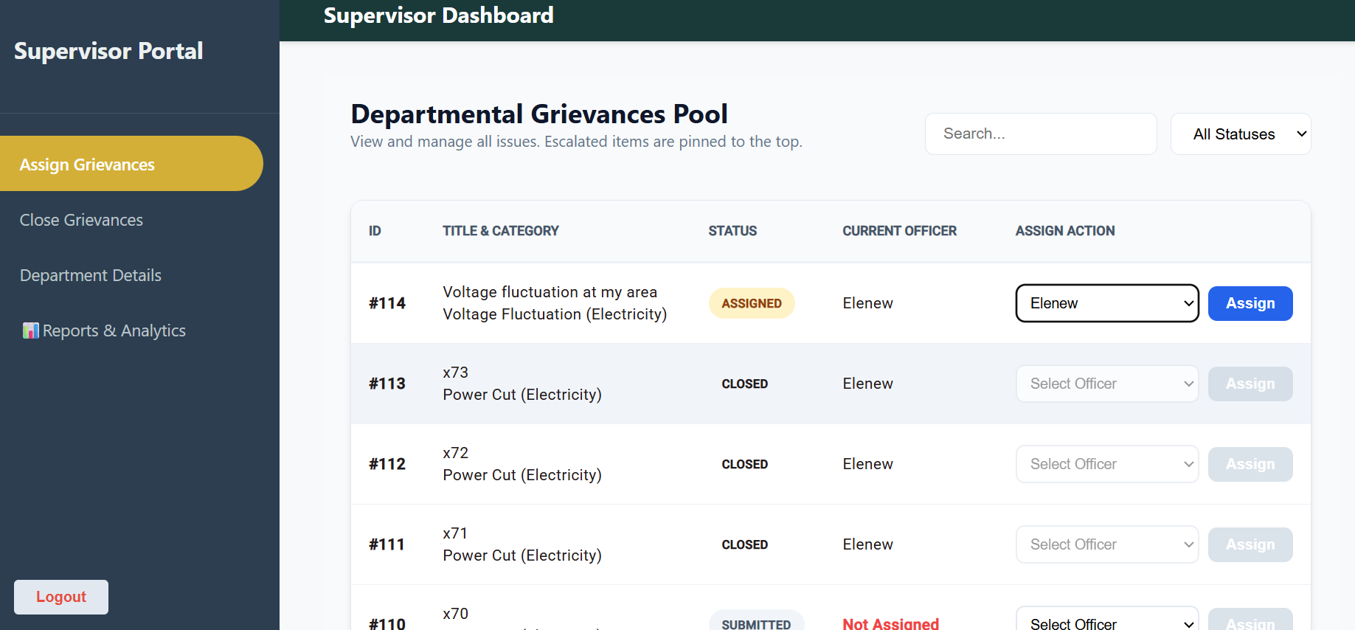
Supervisor-Dashboard/Assign Grievances Page

Slide 17
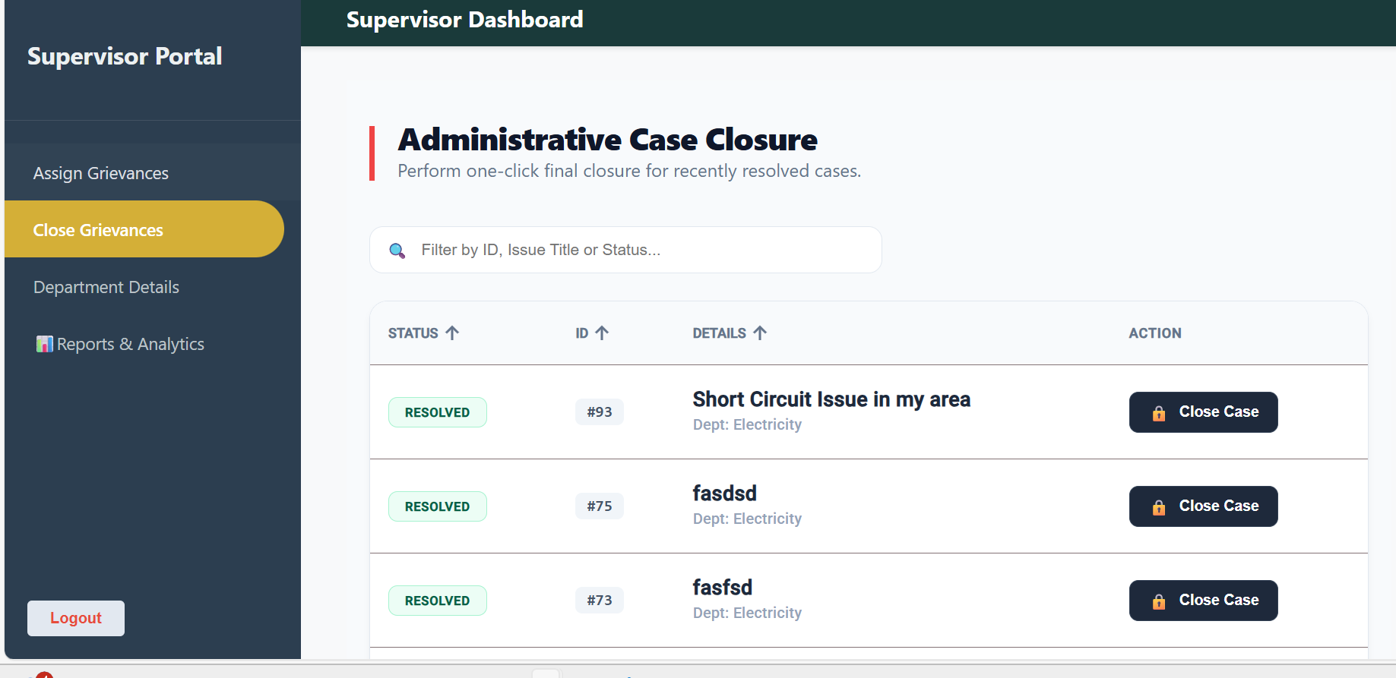
Supervisor-Dashboard/Close Grievances Page

Slide 18
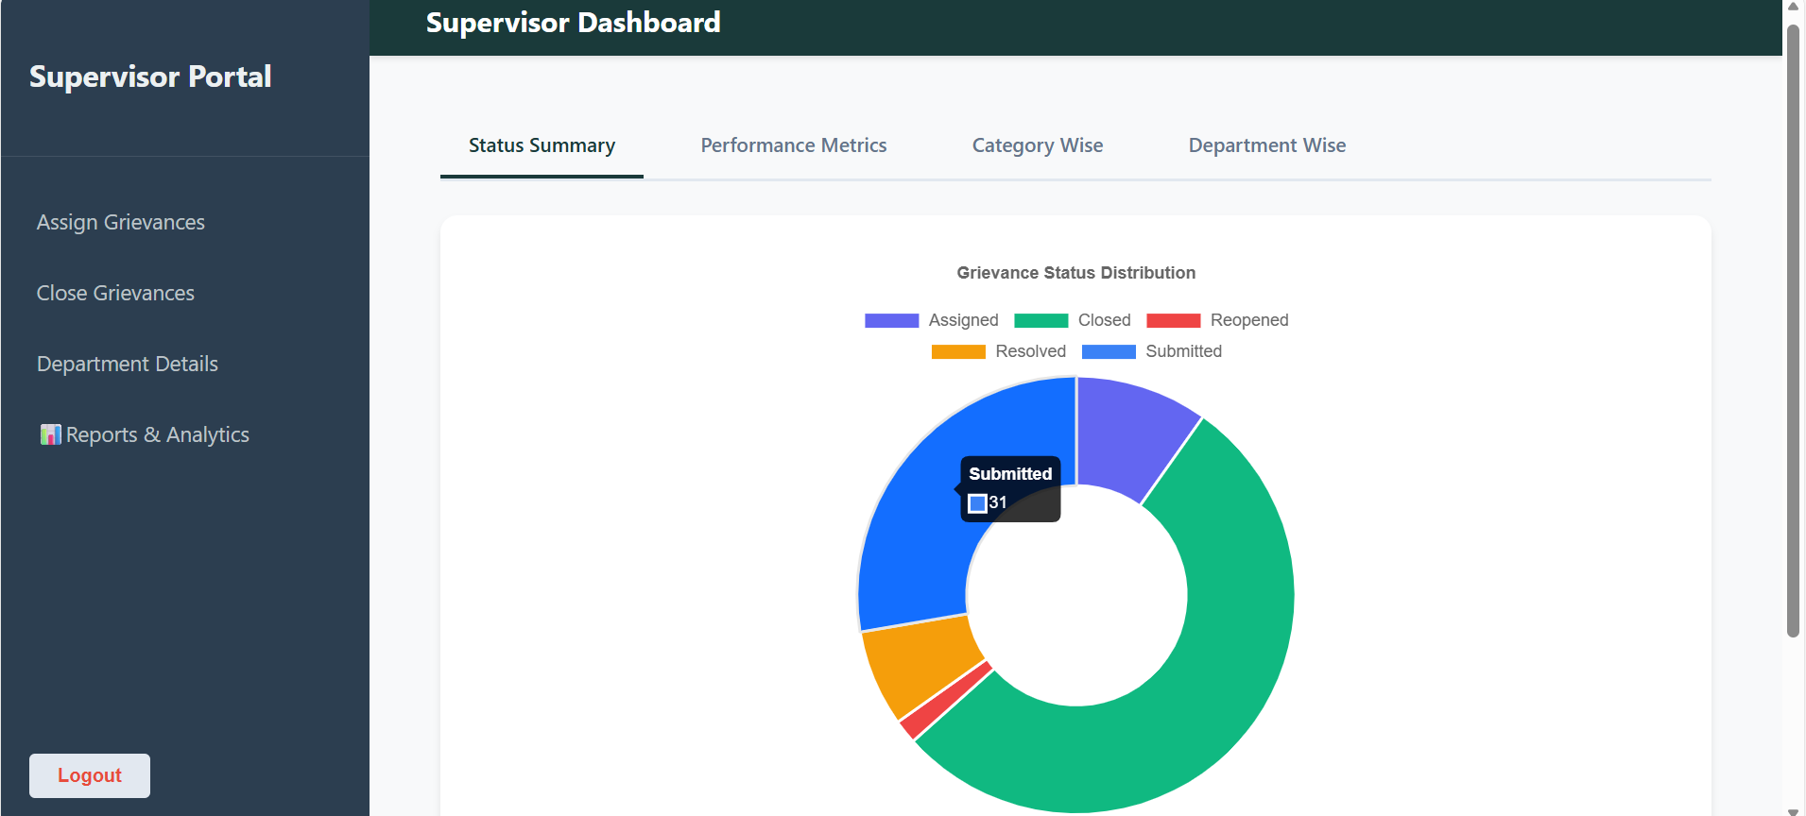
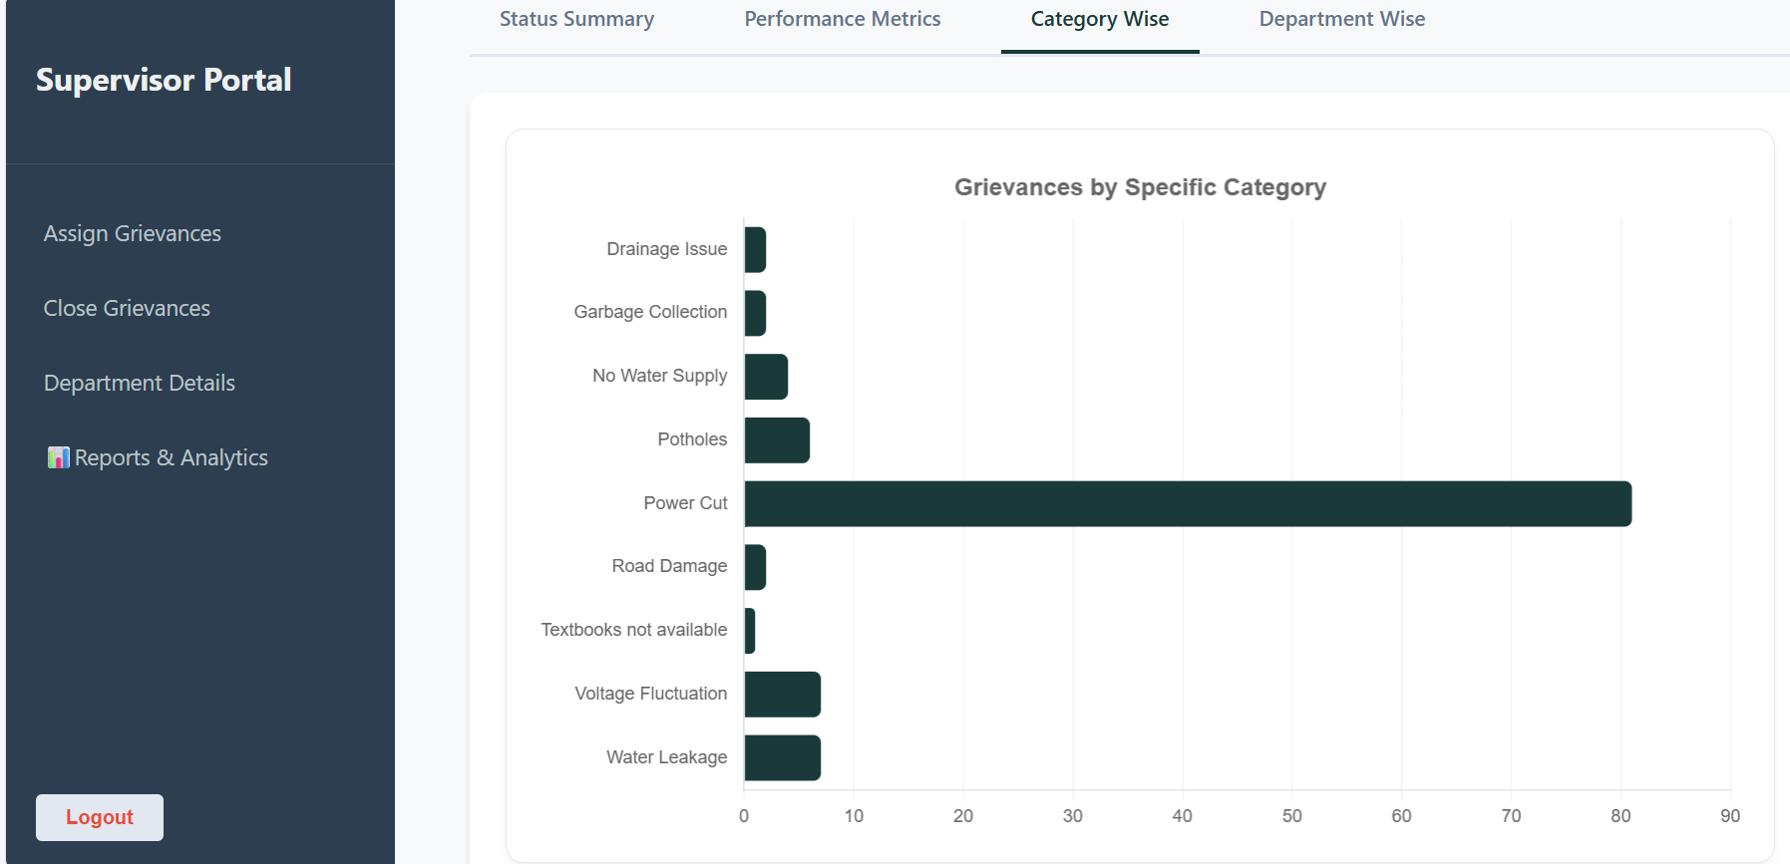
Supervisor-Dashboard/Reports & Analytics Page

Slide 19
Results & Achievements
Successfully implemented core features
Optimized database queries by 40%
Reduced API response time to under 200ms

Slide 20
Live Demonstration
Live Demonstration
See the application in action
▶️

